Slide 1
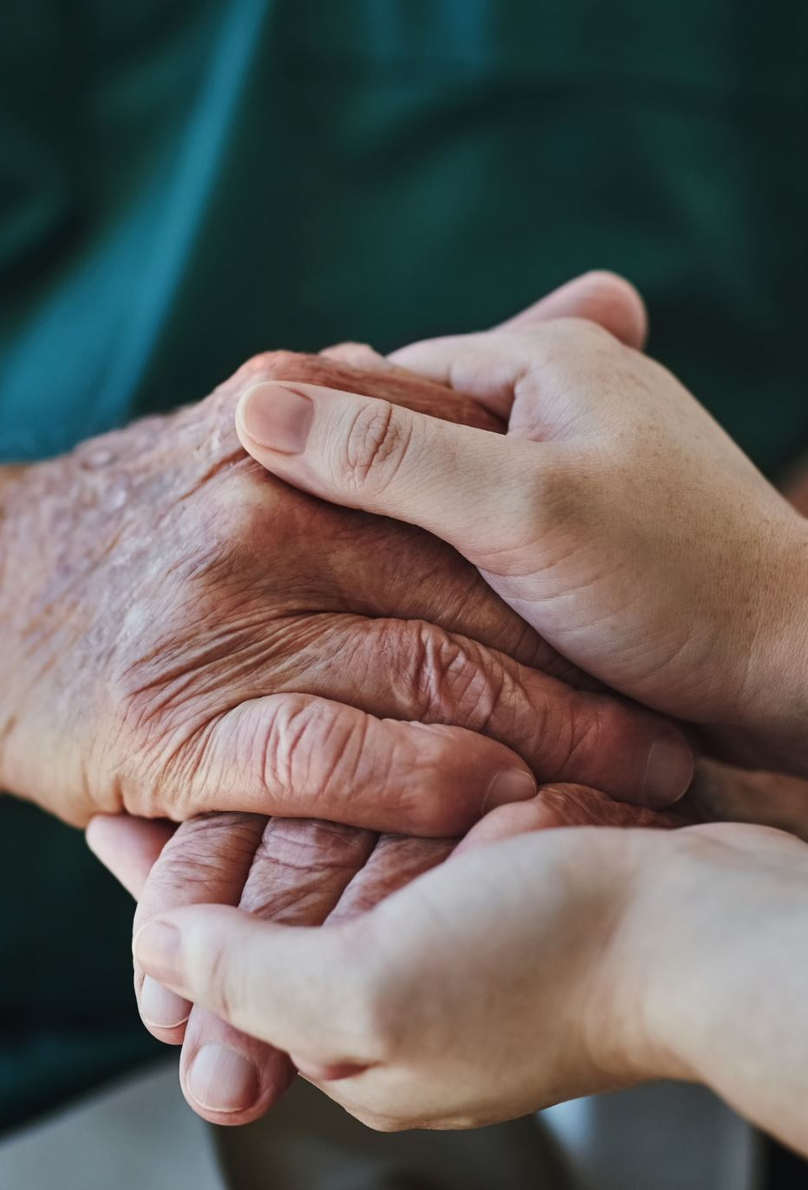
Blessed Assurance
CityAlight

Slide 2
Verse 1
All my attempts to be satisfied were vain and empty

Slide 3
Verse 1
Until the moment You rescued me and Your love filled me
My soul sings, now my soul sings

Slide 4
Chorus
What blessed assurance
I've found in You, I've found in You
I won't be shaken, I will not be moved

Slide 5
Chorus
How steadfast Your strong hand
Is keeping me, is keeping me
I won't be shaken, I will not be moved
O blessed assurance

Slide 6
Verse 2
No other love that I've ever known compares to You, God
No other love that I've ever found has done what You've done
My soul sings, now my soul sings

Slide 7
Chorus
What blessed assurance
I've found in You, I've found in You
I won't be shaken, I will not be moved

Slide 8
Chorus
How steadfast Your strong hand
Is keeping me, is keeping me
I won't be shaken, I will not be moved
O blessed assurance

Slide 9
Bridge
Ever my anchor, ever my strength
Ever my portion, and all I need
Ever my healing, ever my hope
Ever the truth that leads me home
That leads me home

Slide 10
Chorus
What blessed assurance
I've found in You, I've found in You
I won't be shaken, I will not be moved

Slide 11
Chorus
How steadfast Your strong hand
Is keeping me, is keeping me
I won't be shaken, I will not be moved
O blessed assurance

